Slide 1
Day1

Slide 2
Data Source File
https://drive.google.com/drive/folders/1xcmHEYOB0clh54Y4-3EqEd0Fz8X8KYDk

Slide 3
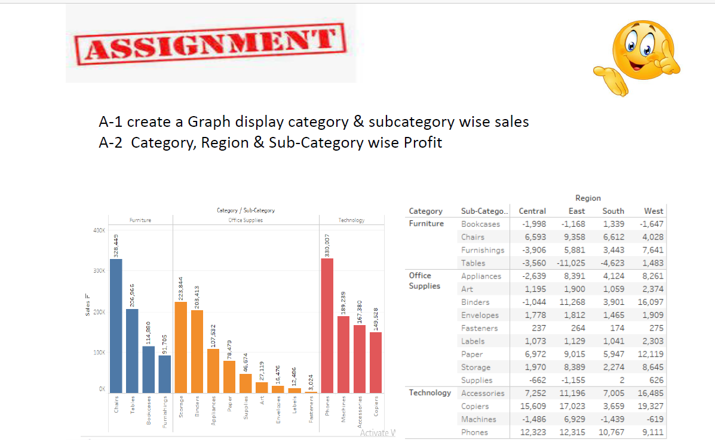
Questions:

Slide 4
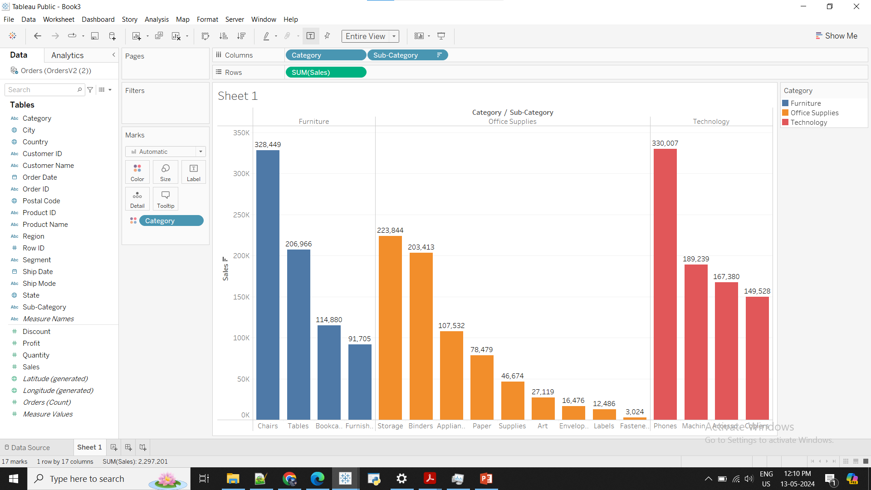
Category & subcategory wise sales

Slide 5
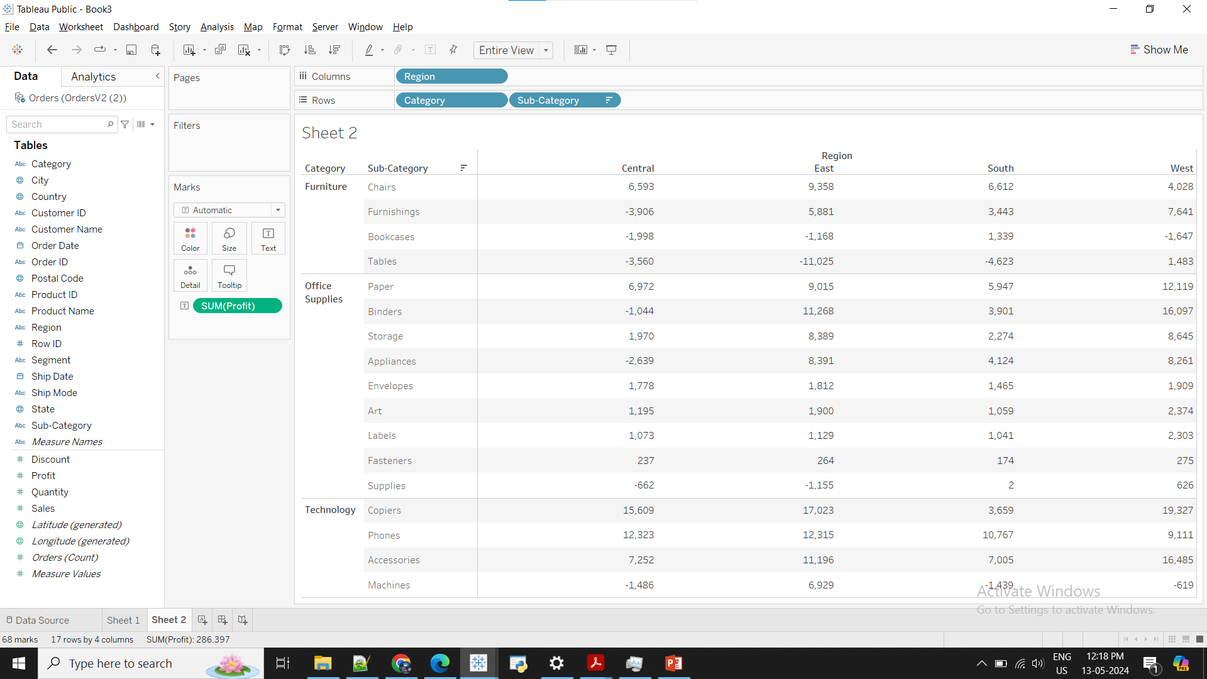
Category, Region & Sub-Category wise Profit

